Slide 1




Europa Se Siente
Development of an expert system/artificial intelligence platform for the modelling and simulation of the behaviour of ground to be treated with resin injection
APPLICANTS
COLLABORATE
PROJECT
RESULTS

Slide 2
Europa Se Siente
DESCRIPTION OF THE PROJECT. OBJECTIVES AND PRIORITIES
The growth of cities and the increase in transportation needs have made the construction of tunnels and underground works increasingly necessary, even in difficult terrain or near other infrastructure. Currently, the injection of cement grouts is the most widely used solution for the stabilization and waterproofing of the ground. However, a promising alternative is resin injection techniques, which are currently used in repair work or in corrective actions in emergency situations when cement application does not offer satisfactory results. These techniques make it possible to address the main problems that arise in underground works, mainly related to water inflows and ground instabilities. However, to date, it is an activity, from a scientific point of view, practically unexplored and with very limited research support, since they are of recent and novel application. The main objective of the INRESTE project is to analyse the improvement of the geomechanical properties of different soils by injecting resins, to develop a platform based on artificial intelligence to predict and simulate the behaviour of the soil after treatment. In this way, the technical knowledge bases are laid that will allow the standardization of resin injection activities, so that reference geomechanical parameters can be defined for each type of treated soil with certain operational variables. The results of the project will make it possible to determine, in advance, the stress–strain behaviour of any type of soil subjected to a resin injection treatment, promoting the use of this technique and extending its use to many situations addressed during the design and construction phases.
HOME
GEOGRAPHICAL SCOPE
FUNDING RECEIVED
DURATION
RESULTS

Slide 3
Europa Se Siente
GEOGRAPHICAL SCOPE
With regard to the geographical scope of the project, it was carried out at the soil sampling sites of the different soil types, as well as at the facilities of the applicant company, at the subcontracted centre, and at the accredited laboratory for particle size analysis tests:
Locations: Principiado de Asturias
ATEGLOB: Principiado de Asturias
CEMOSA: Principiado de Asturias
Universidad de Vigo: Galicia
THEMATIC SCOPE
With regard to the thematic scope of the project, it falls within the development of artificial intelligence-based solutions applied to geomechanics.
HOME
DESCRIPTION
FUNDING RECEIVED
DURATION
RESULTS

Slide 4
Europa Se Siente
FUNDING RECEIVED
The project budget amounted to 481,164 euros, with a CDTI funding of 408,989 euros.
The gross grant equivalent of the project was 227,697 euros.
HOME
DESCRIPTION
GEOGRAPHICAL SCOPE
DURATION
RESULTS

Slide 5
Europa Se Siente
PROJECT DURATION
At the time of application, the project contemplated a duration of 24 months, between September 2023 and August 2025.
However, during its execution, it was necessary to request an extension from CDTI, so the total duration of the project was 30 months.
HOME
DESCRIPTION
GEOGRAPHICAL SCOPE
FUNDING RECEIVED
RESULTS

Slide 6
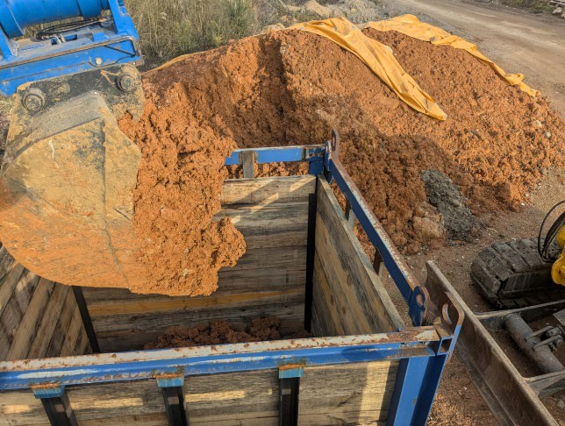
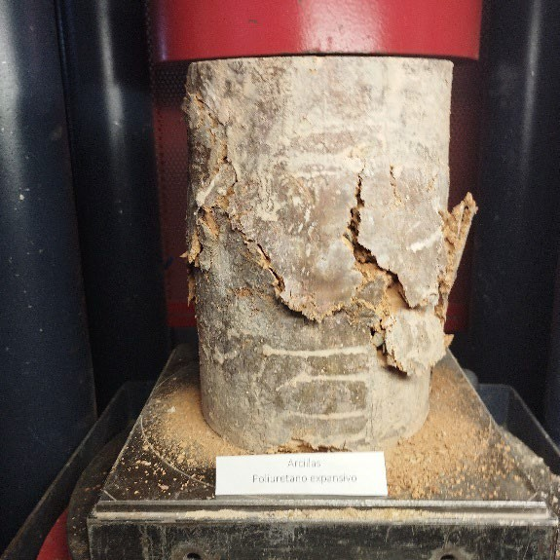
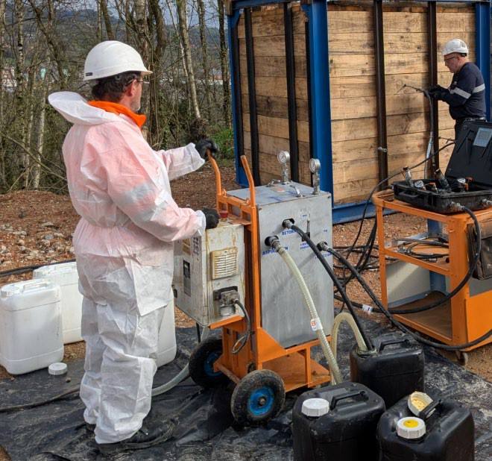
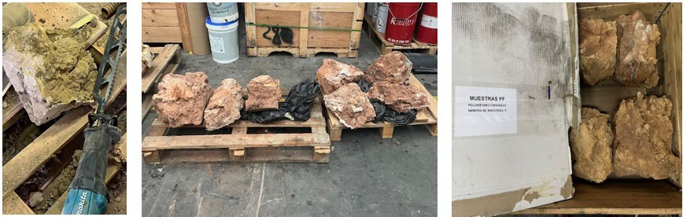
Europa Se Siente
RESULTS
SOILS
CLAY | C
SILT-CLAY | MC
SILT | M
SAND-SILT | SM
SAND | S
GRAVEL-SAND | GS
GRAVEL | G
Filling of the enclosure with soil type for injection
Unconfined compression test sample
Treated soil samples
Injection Process
HOME
DESCRIPTION
GEOGRAPHICAL SCOPE
FUNDING RECEIVED
DURATION

Slide 7
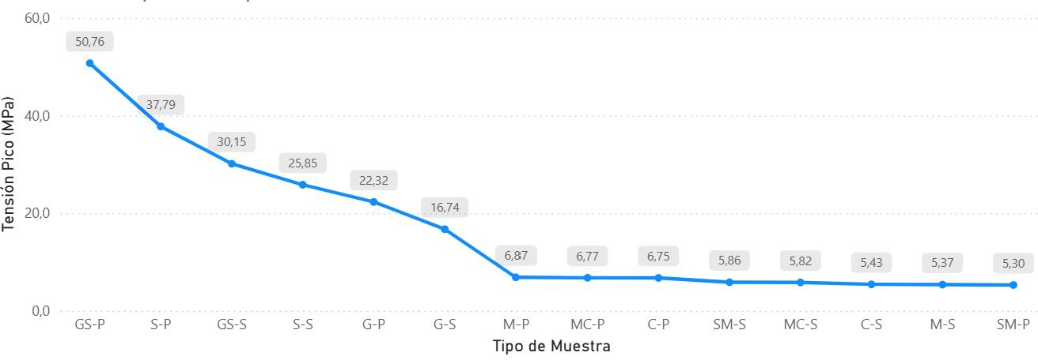
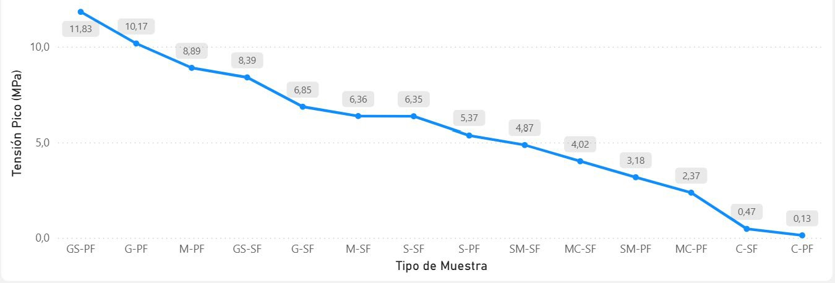
Europa Se Siente
RESULTS
Unconfined compressive strength of non-expansive resins
Pre-treatment vs post-treatment density
Unconfined compressive strength of expansive resins
HOME
DESCRIPTION
GEOGRAPHICAL SCOPE
FUNDING RECEIVED
DURATION

Slide 8
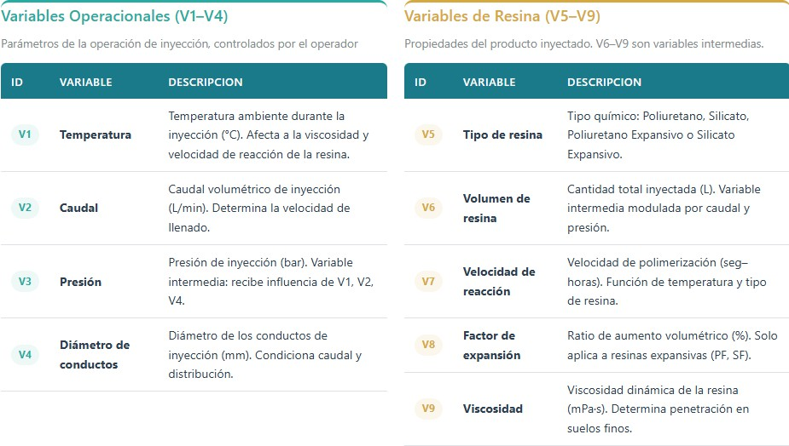
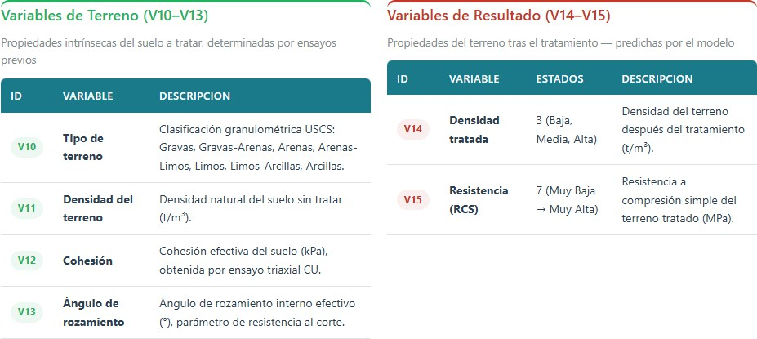
Europa Se Siente
RESULTS
Variables of the WEB simulator
HOME
DESCRIPTION
GEOGRAPHICAL SCOPE
FUNDING RECEIVED
DURATION

Slide 9
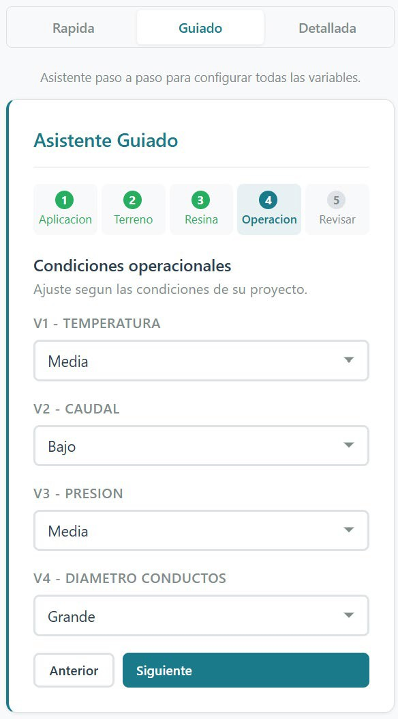
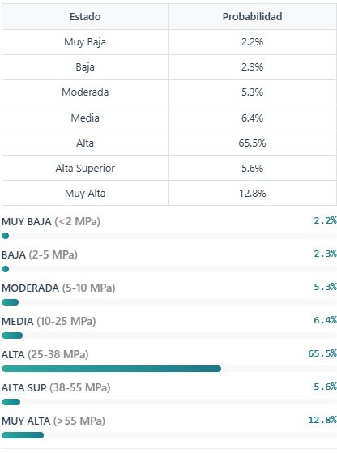
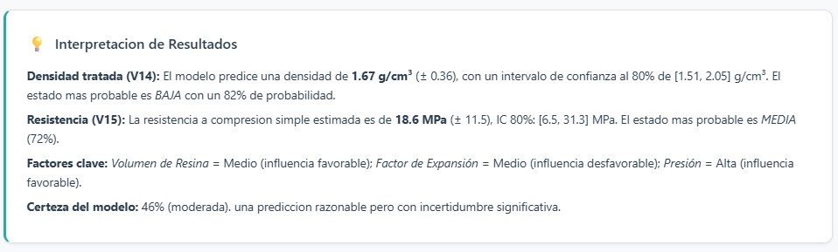
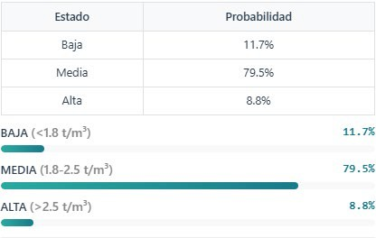
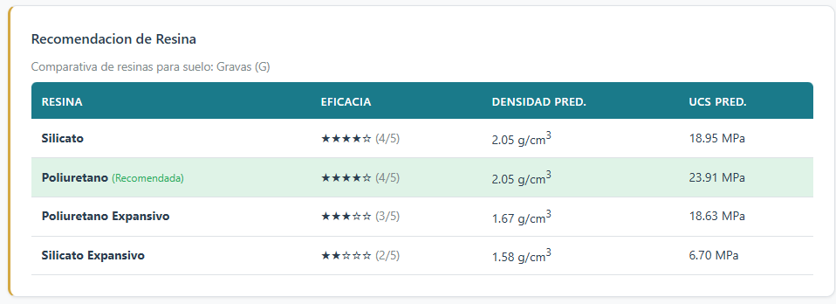
Europa Se Siente
RESULTS
INRESTE WEB Simulator
HOME
DESCRIPTION
GEOGRAPHICAL SCOPE
FUNDING RECEIVED
DURATION

Slide 10
Europa Se Siente
RESULTS
Main conclusions of the INRESTE project:
Seven reference soil types were validated.
Satisfactory results were obtained in the injection treatments of the seven soil types with different resins.
An effective expert consultation system was designed and implemented, which made it possible to systematically capture the available knowledge on the prediction of properties in resin-treated soils..
A quality quantitative dataset was consolidated, representative of various resin injection scenarios.
The development of a predictive model was carried out, which was materialised in a pilot web application (artificial intelligence platform) useful for engineers in the field.
HOME
DESCRIPTION
GEOGRAPHICAL SCOPE
FUNDING RECEIVED
DURATION

